Slide 1
Data Flow Testing

Slide 2
Define/Reference Anomalies
A variable is defined but never used / referenced.
def calculate_total(price, tax):
total = price + tax # 'total' is defined
return tax # 'total' is never used or referenced
A variable is used but never defined.
def display_message():
print(message) # 'message' is used here
message = "Hello, world!"
A variable is defined twice before it is used.
def set_status(status_code):
current_status = "pending" # First definition
current_status = "active" # Second definition, overwriting the first
print(current_status) # 'current_status' is used here
A variable is used before even first-definition.
def process_data(data):
# The programmer mistakenly uses 'data_processed' here,
# before it has been defined.
processed_result = data_processed * 2
# The definition happens later.
data_processed = data + 10

Slide 3
Terms
Definition (d): A point in the code where a variable is assigned a value (e.g., x = 5;).
Use (u): A point where a variable's value is read or referenced. There are two types:
C-use (Computation Use):Used in a calculation or expression. Example: y = x +1.
P-use (Predicate Use): Used in a logical condition that influences control flow. Example: if (x > 5).
Undefined (a): The state of a variable after it is declared but before it is assigned a value.
int myNumber; // 'myNumber' is in the undefined state

Slide 4
Definitions
Defining node
A node of a program graph is a defining node for a variable , if and only if, the value of the variable is defined in the statement corresponding to that node. It is represented as DEF ( , n) where is the variable and n is the node corresponding to the statement in which is defined.
Usage node
A node of a program graph is a usage node for a variable , if and only if, the value of the variable is used in the statement corresponding to that node. It is represented as USE ( , n), where ‘ ’ is the variable and ‘n’ in the node corresponding to the statement in which ‘ ’ is used.
C-Use
P-Use

Slide 5
Definitions
Definition use Path
A definition use path (denoted as du-path) for a variable ‘v ’ is a path between two nodes ‘m’ and ‘n’ where ‘m’ is the initial node in the path but the defining node for variable ‘v ’ (denoted as DEF ( v, m)) and ‘n’ is the final node in the path but usage node for variable ‘ v’ (denoted as USE ( v, n)).
Definition clear path
A definition clear path (denoted as dc-path) for a variable ‘ v’ is a definition use path with initial and final nodes DEF ( v, m) and USE (v , n) such that no other node in the path is a defining node of variable ‘v ’.
The du-paths that are not definition clear paths are potential troublesome paths.

Slide 6
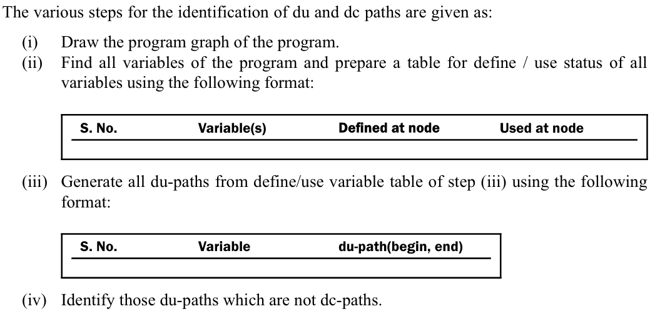
Identification of du and dc Paths

Slide 7
Testing Strategies Using du-Paths
Test all du-paths
All du-paths generated for all variables are tested. This is the strongest data flow testing strategy covering all possible du-paths.
Test all uses
Find at least one path from every definition of every variable to every use of that variable which can be reached by that definition. For every use of a variable, there is a path from the definition of that variable to the use of that variable.
Test all definitions
Find paths from every definition of every variable to at least one use of that variable; we may choose any strategy for testing.

Slide 8
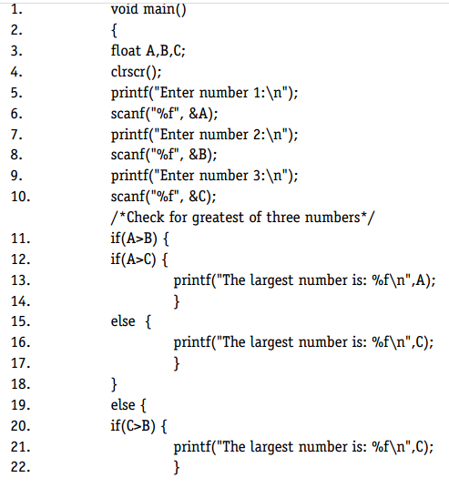
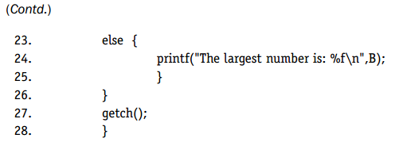
Generation of Test Cases

Slide 9
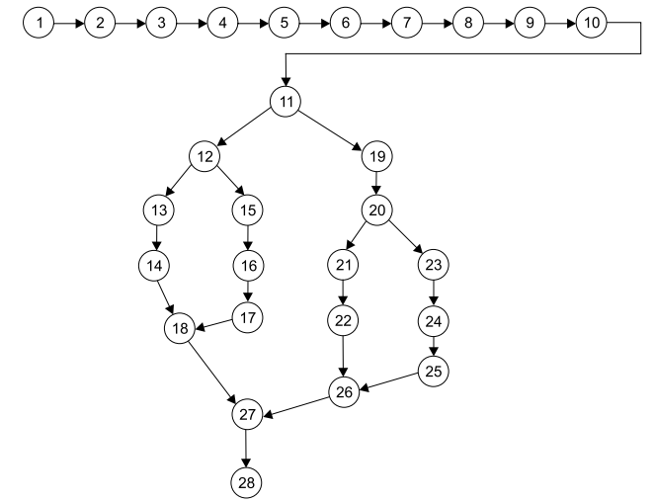
Generation of Test Cases

Slide 10
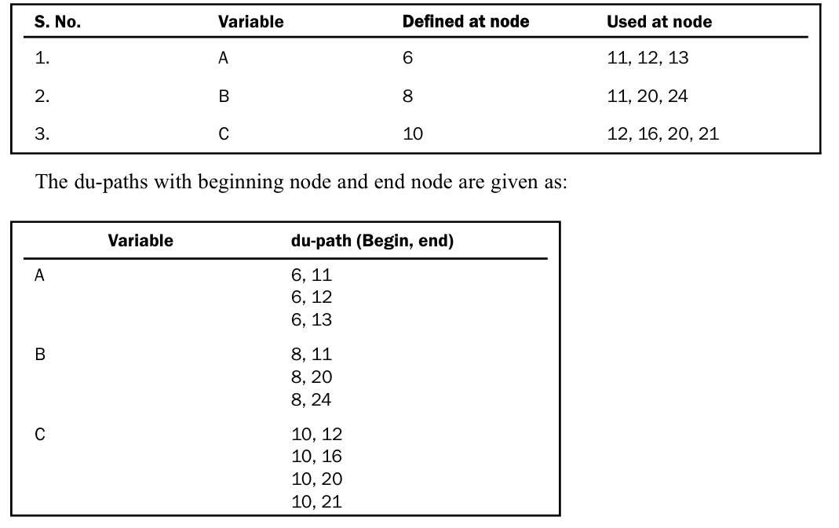

Slide 11
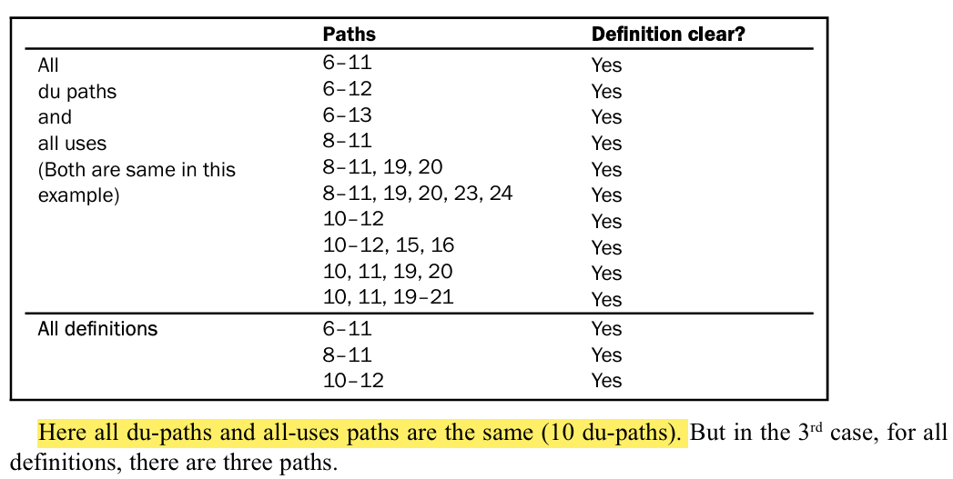

Slide 12
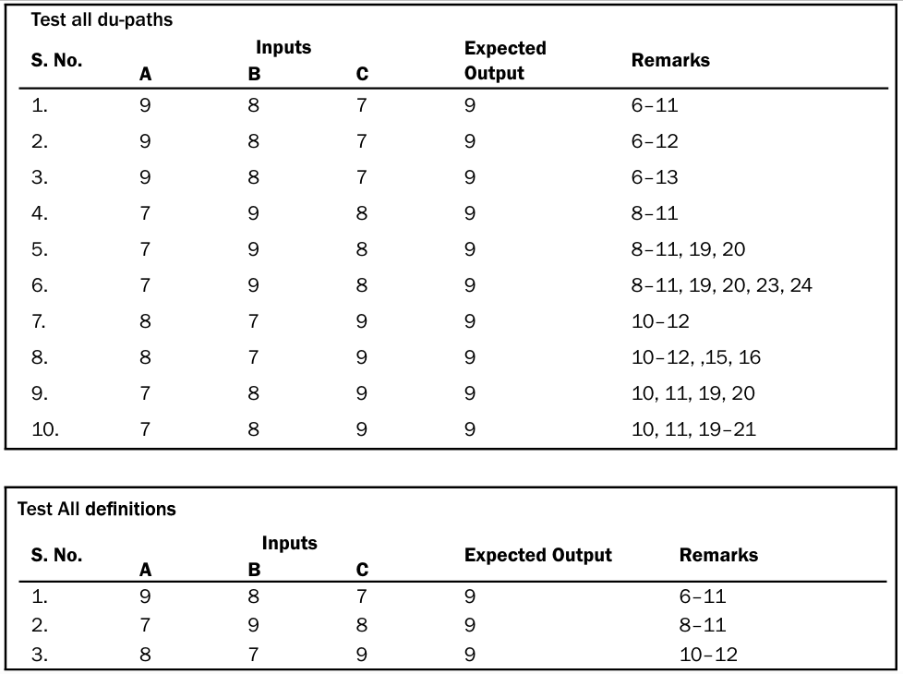

Slide 13
In this example all du-paths and all uses yield the same number of paths.
This may not always be true. If we consider the following graph and find du paths with all three strategies, we will get a different number of all-du paths and all-uses paths.

Slide 14
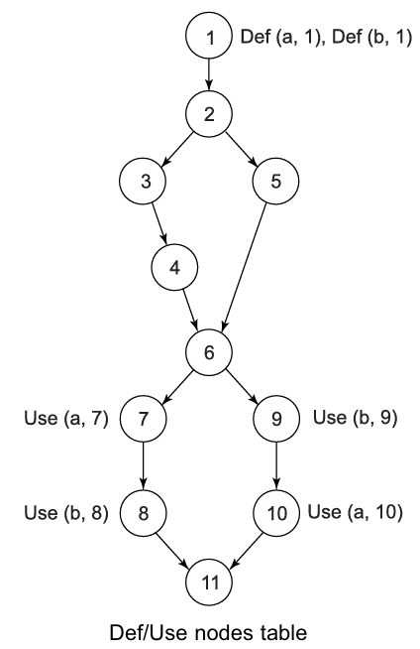

Slide 15
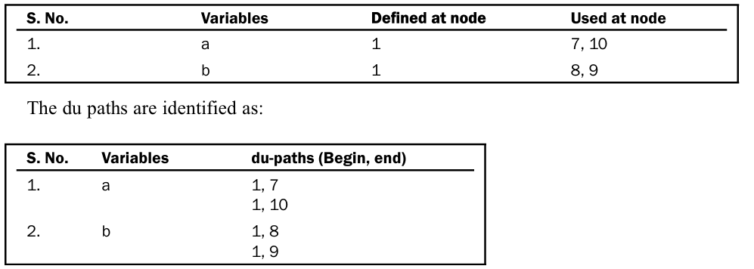

Slide 16
